Slide 1

ADVANCED PROGRAMMING-ITIC 2223
Lecture 01-Introduction to Python Programming
Ramesh Madhuranga
MPhil.(Reading) (USJP), BICT (Hons) (RUSL), AMCSSL
Department of Biosystems Technology
Faculty of Technology
Kotelawala Defence University

Slide 2
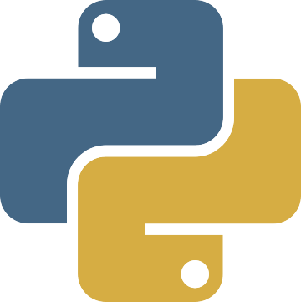
What is Python?
Python is an interpreted, high-level, general-purpose programming language.
Created by Guido van Rossum – late 1980
First released on February 20, 1991
Python is Object-Oriented
Python is a Beginner's Language
Open Source Programming Language

Slide 3
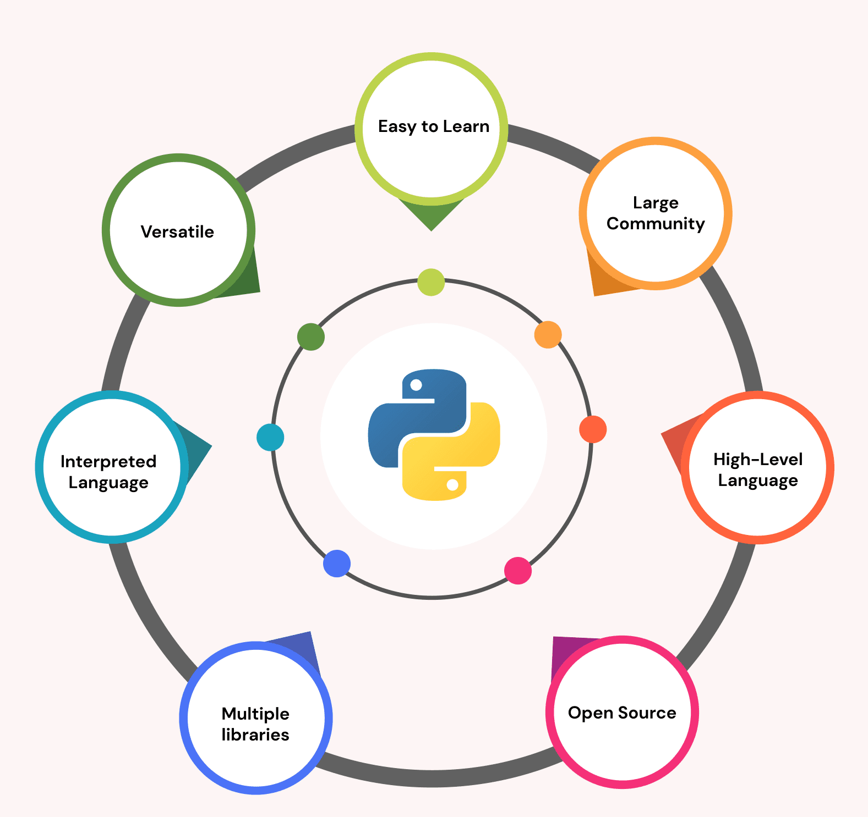
Why Python?

Slide 4
Easy to learn: Python is meant for its simplicity and readability, making it easy for beginners who are very interested in learning Python. The language has a simple syntax similar to writing English, and its code is often referred to as "executable pseudocode," which is easy to read and understand.
Versatile: Python is a programming language that can be used for many applications such as web development, data science, and machine learning. A library that is standard, along with built-in functions and modules, makes it possible to write complex programs with minimal code. Also, programmers can publish their own modules.
Large community: Python has a large and active developer community, with many resources available for learning and using the language. There are many libraries and frameworks for understanding advanced concepts.

Slide 5
High-Level Language: Python is considered a high-level language, which simplifies many low-level details of computer programming, like memory management and pointer arithmetic. Python makes writing and reading code easier as it has its own garbage collector and can reduce the time needed to develop and maintain software.
Open Source: Python is a language anyone can use, change, and give away for free. Many developers like to use it because they can make it work just how they want it to.
Interpreted Language: Python is an interpreted language that can run directly from the source code without compiling. This makes writing, testing, and debugging code easy and can speed up the development process.
Python has multiple libraries, frameworks, and packages: Python includes numerous amount of libraries that can be used just by importing. A number of popular and powerful Python libraries are available, including NumPy and Pandas for Data Science, Matplotlib and Seaborn for Data Visualization, and sklearn, Keras, PyTorch, etc., for Machine Learning.

Slide 6
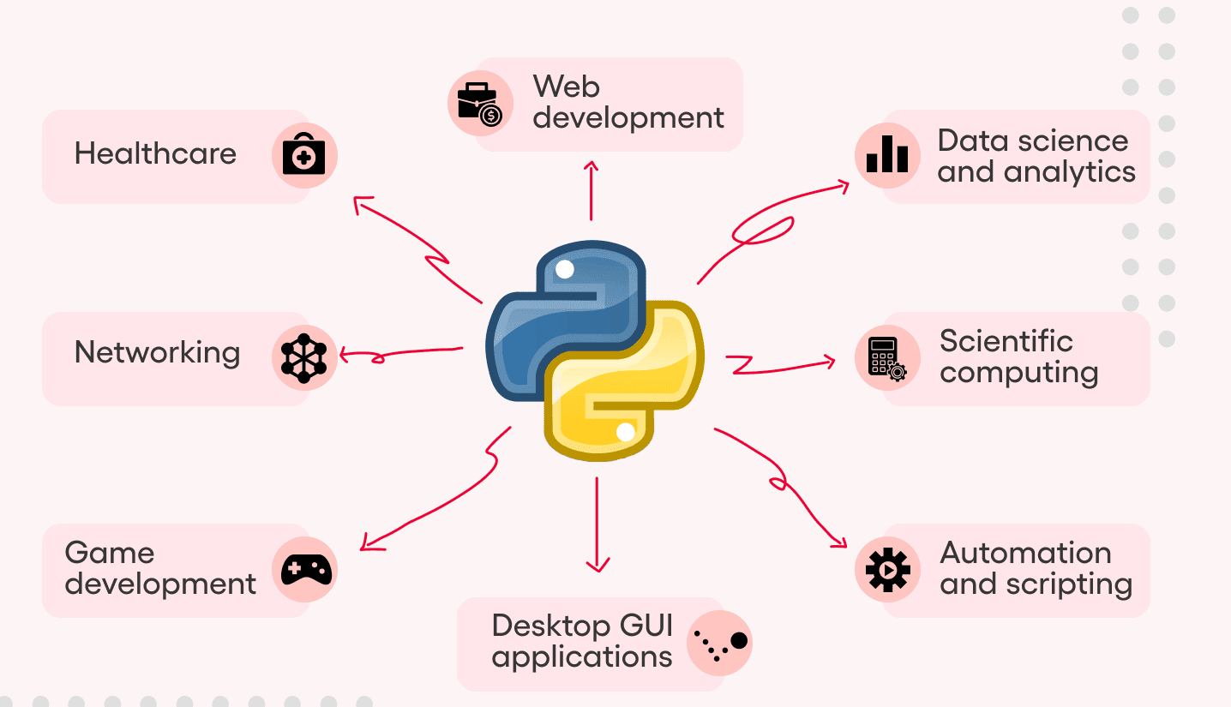
Applications

Slide 7
Web development: Django, Flask, and Pyramid are popular web frameworks in Python, used for building applications ranging from small websites to large enterprise applications.
Data science and analytics: Python is a highly demanded language in data science and machine learning, with popular libraries like NumPy, Pandas, Matplotlib, and Scikit-learn for data analysis, visualization, and ML.
Scientific computing: Python is widely used in scientific computing, with modules for numerical calculations, optimization, linear algebra, interpolation, and special functions. Libraries like SciPy and NumPy provide a powerful way to perform scientific computations.
Automation and scripting: Python is extensively used for automation tasks, such as scripting, testing, and deployment, providing an efficient way to automate repetitive tasks and integrate systems and services.

Slide 8
Desktop GUI applications: Python provides several GUI toolkits like Tkinter, PyQt, and wxPython, allowing developers to create desktop applications with a native look and feel.
Game development: Python can be used to develop games with libraries like Pygame, which provides graphics, sound, and input handling tools for game development.
Networking: Python has robust networking libraries, such as sockets and Requests, which make it easy to create network-based applications, such as web scrapers and web crawlers.
Education: Python's simplicity and ease of use make it a popular choice for introductory programming courses in academia and online.

Slide 9
DevOps: Python is used extensively in the DevOps community for tasks such as automation, infrastructure management, and deployment. Tools such as Ansible and SaltStack are written in Python.
Finance: Python is widely used for quantitative analysis, algorithmic trading, and risk management. Banks such as JPMorgan and Goldman Sachs use Python for financial modeling and analysis.
Healthcare: Python is used for medical imaging, data analysis, and research. The National Institutes of Health (NIH) uses Python for genomic data analysis.

Slide 10
Features of Python Programming
For learning it is easy and to use: Python is easy to learn and use, even for beginners. The syntax is plain and straightforward, almost like writing in English.
Object-oriented: Python is an object-oriented programming language that has highlights such as code reusability and measured quality. It supports highlights such as abstraction, encapsulation, inheritance and polymorphism.
Interpreted: Python is an interpreted language, which implies line by line the code is executed. This makes the process faster and more efficient as it eliminates the need for a compilation step, and if some error occurs, it will not wait for the whole code to compile. It will throw an error at that particular line itself.

Slide 11
Cross-platform: Python has the capability to run on multiple platforms, including Windows, Mac, Linux, and Unix. This makes it highly portable, allowing developers to write code on one platform and run it on another.
Extensive standard library: Python has an extensive standard library that contains modules for many everyday tasks, e.g. file input/output, regular expressions and networks. This reduces the code developers have to write and saves time and effort.
Dynamically typed: Python is dynamically typed, meaning variable types are determined at runtime. We don't have to tell the data type of the variable explicitly. This makes the language more flexible and adaptable to changing requirements.

Slide 12
High-level language: Python may be a high-level language, meaning that it abstracts absent numerous of the low-level points of interest of computer hardware. This permits designers to focus on the problem they are attempting to unravel, instead of the usage points of interest.
Support for numerous programming ideal models: Python supports numerous programming standards, counting procedural, functional and object-oriented programming. This makes it exceedingly versatile to distinctive coding styles and extend necessities.
Free and open source: The Python programming language is free and open source, which suggests it can be utilized on any working framework for complimentary. You'll be able download Python and the related libraries and documentation from the official Python site. In expansion to downloading, you'll too make and convey your possess modules or libraries.

Slide 13
Extensive feature: The Python programming language can be extended and is more versatile than many other programming languages. Its adaptability to various functionalities makes Python a universal programming language in the software development industry. Code written in different programming languages can be executed. Python gains new capabilities and functionality by integrating code from other programming languages.
Database support: Python provides robust support for working with databases through its standard library and third-party packages such as SQLite3, MySQL Connector, PostgreSQL, SQLAlchemy, and MongoDB. Python also supports Object-Relational Mapping (ORM) frameworks such as Django ORM and SQLAlchemy, which provide an abstraction layer on top of databases, making it easier to work with data in object-oriented Python code.

Slide 14
GUI Programming Support: Python provides several GUI programming frameworks and libraries, including Tkinter, PyQt, and wxPython where. Tkinter is a standard GUI toolkit included in Python. PyQt delivers a powerful and flexible toolkit for creating cross-platform desktop GUI applications, and wxPython provides a native look and feels for desktop GUI applications on Windows, macOS, and Linux.

Slide 15
Python Basic’s
Python programs and modules are written as text files with traditionally a .py extension
Variable in Python need no declaration
  >>> c=1
Objects always have a type

Slide 16
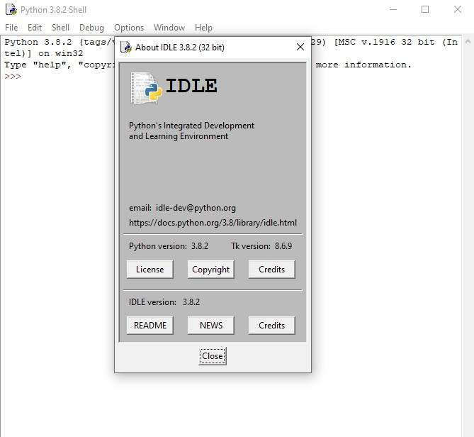
Python IDLE
IDLE is an Integrated Development and Learning Environment for Python

Slide 17
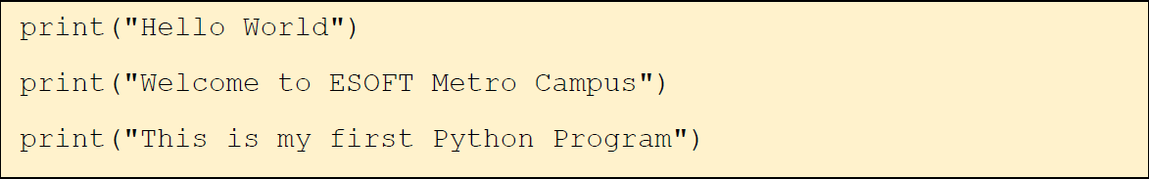
How to Write a Program
The python code has to be saved with a filename and .py extension.
For Example, Let’s save this file as test.py

Slide 18
How to Execute a Program
test.py file can be executed at command line by invoking the interpreter on your application.
C: > python test.py

Slide 19
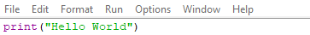
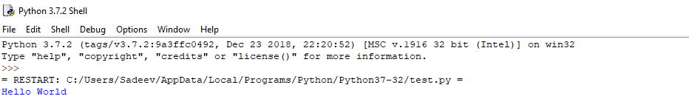
Run Python Script using an IDLE
You can run the script by going "Run --> Run Module" or simply by hitting F5

Slide 20
Lesson Summary
What is Python and Python Used For?
Features of Python
Python IDLE
How to Write a Program
How to Execute a Program

Slide 21
Conclusion
Python is easy to learn and use, object-oriented, interpreted, cross-platform, has an extensive standard library, is dynamically typed, supports multiple programming paradigms, is free and open source, and supports databases and GUI programming. Python has a number of applications, including web development, data science and analytics, scientific computing, machine learning, artificial intelligence, game development, and more. Python's popularity, powerful libraries, and active community of developers make it a go-to choice for many programming tasks.

Slide 22
HAVE A NICE DAY!

